Slide 1

Introduction to Robotics
CSE 461
Riad Ahmed
Lecturer, Dept. of Computer Science and Engineering
Brac University
Lecture 4: Chapter 1(Introduction to robotics: basics)

Slide 2
Previous Class
Subsystem

Slide 3
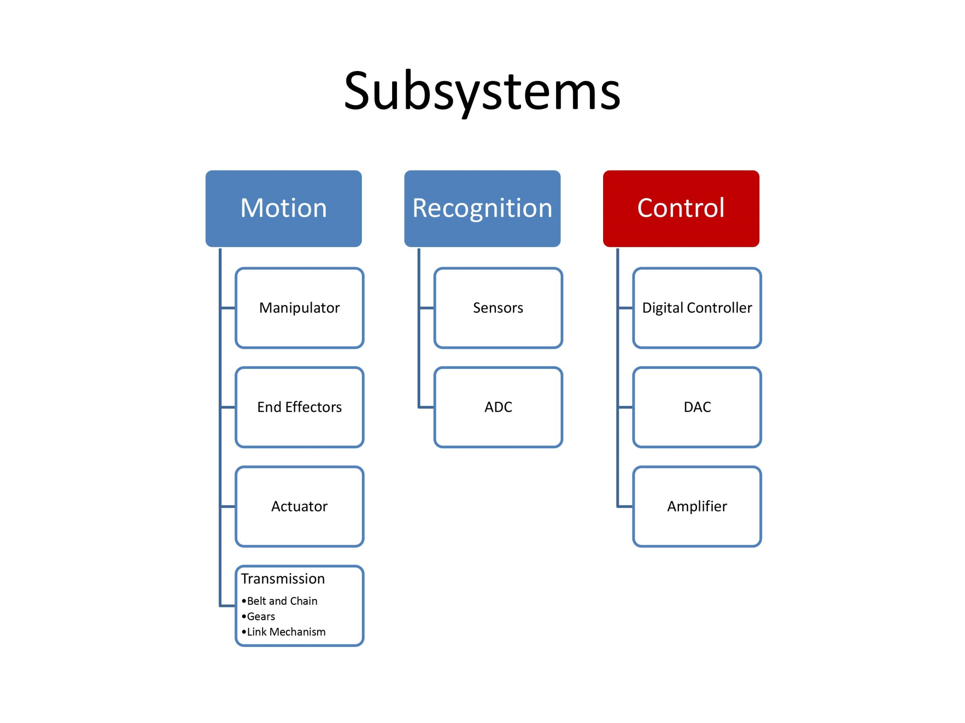

Slide 4
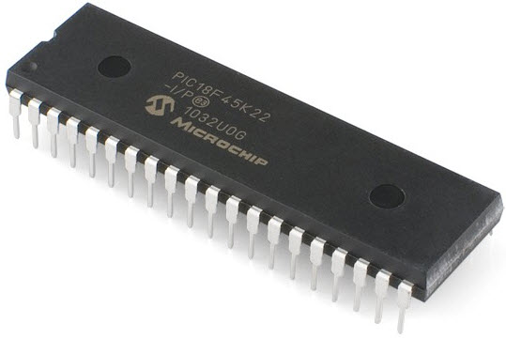
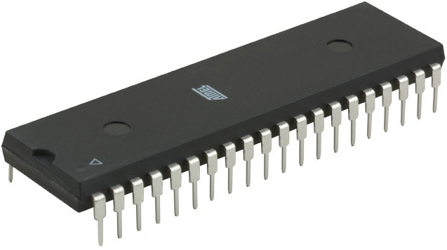
Microcontrollers
A microcontroller is a small, integrated circuit that contains a processor, memory, and input/output peripherals.

Slide 5
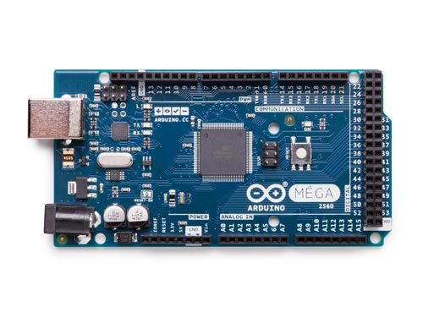

Arduino

Slide 6
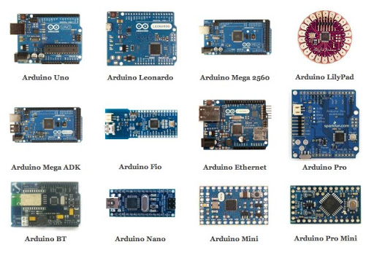
Arduino

Slide 7
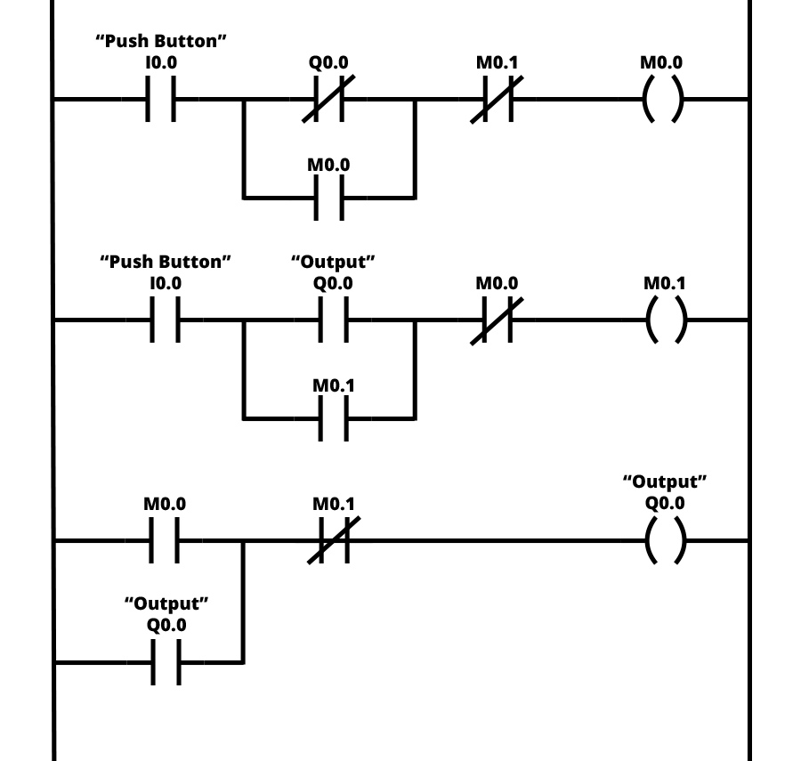
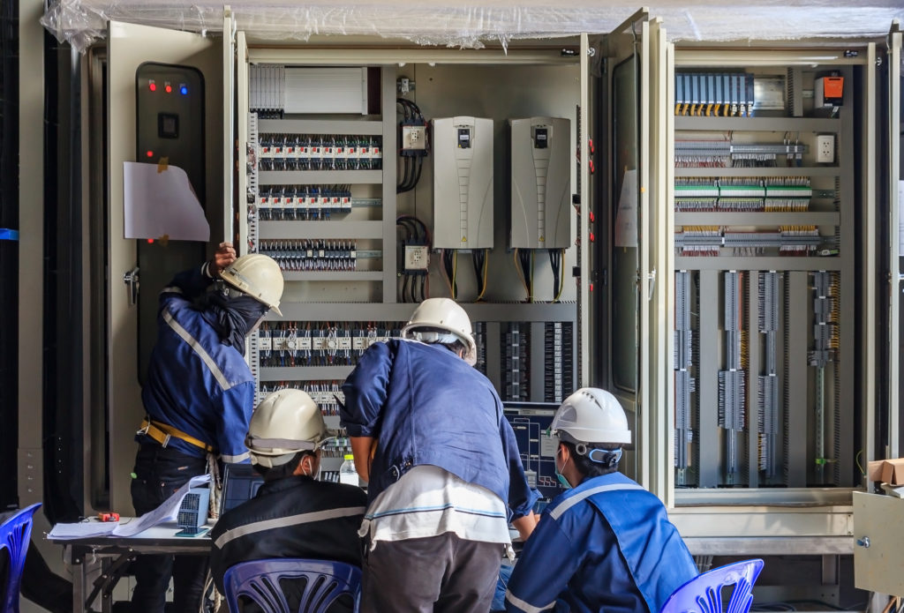
Programmable Logic Controller (PLC)

Slide 8
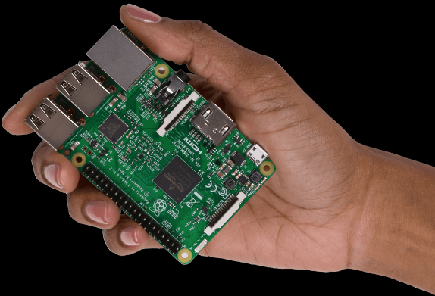
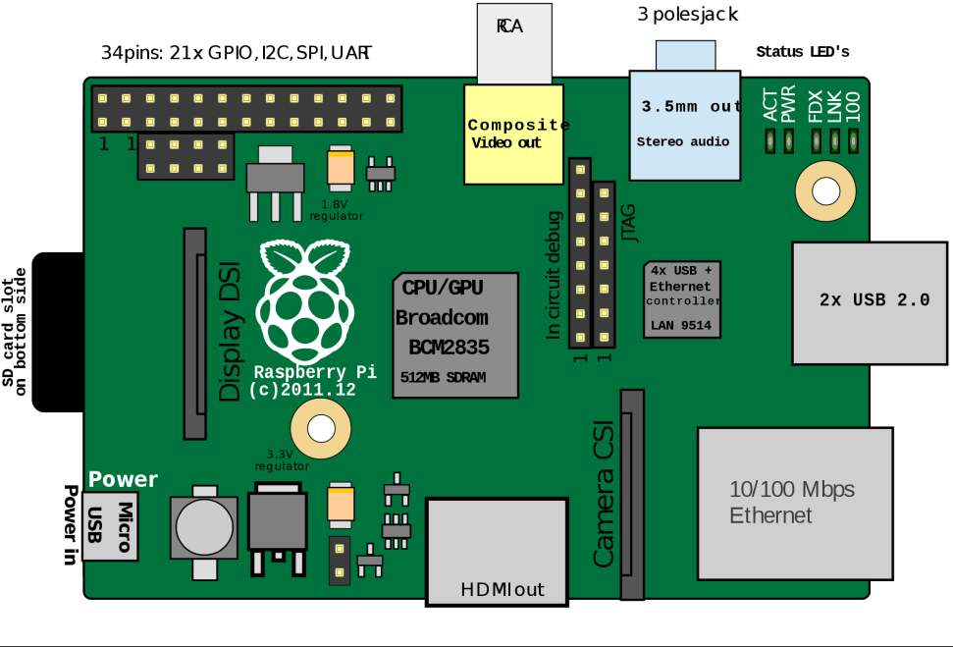
Single board Computer

Slide 9
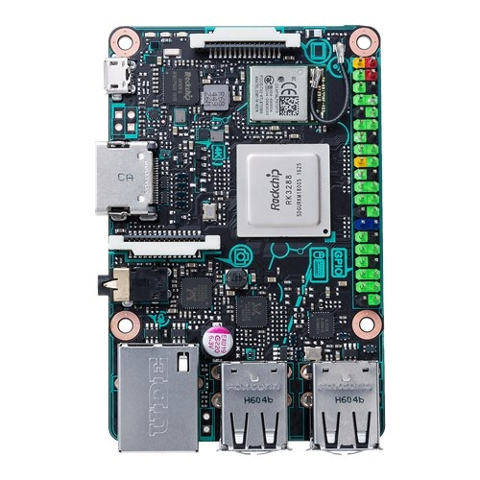
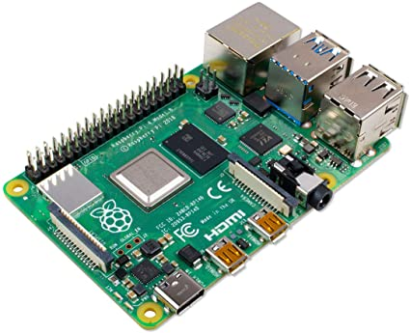
Raspberry PI 4, Tinkerboard

Slide 10
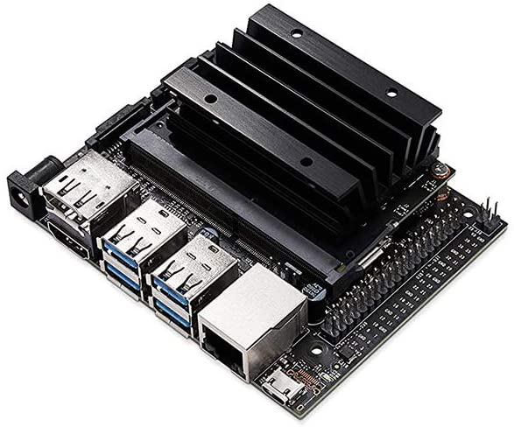
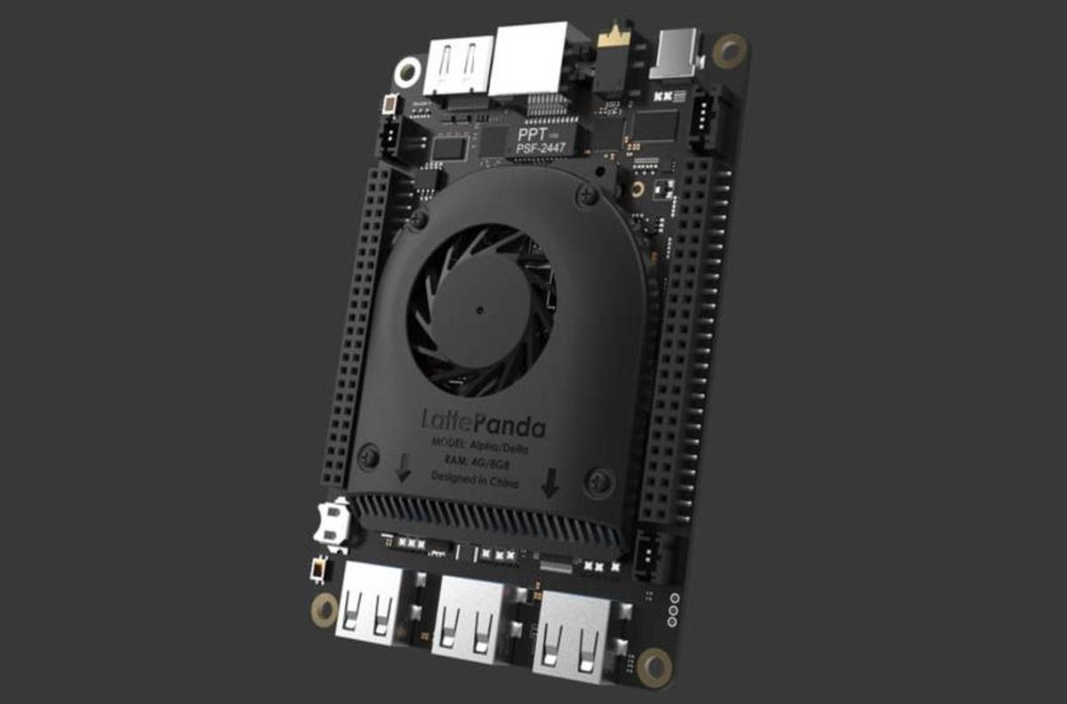
Little Panda and Jetson nano

Slide 11
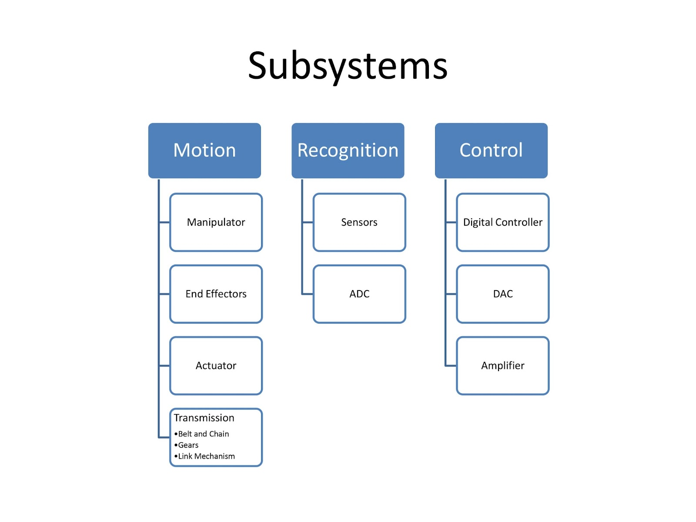

Slide 12
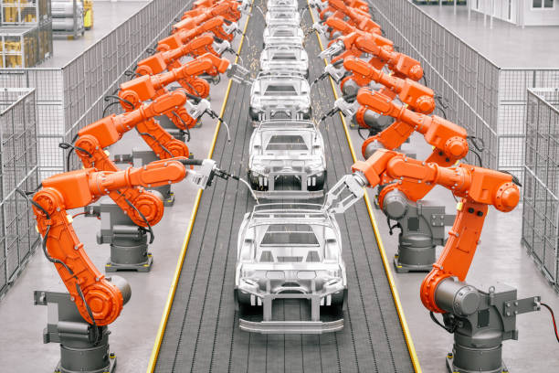

Slide 14
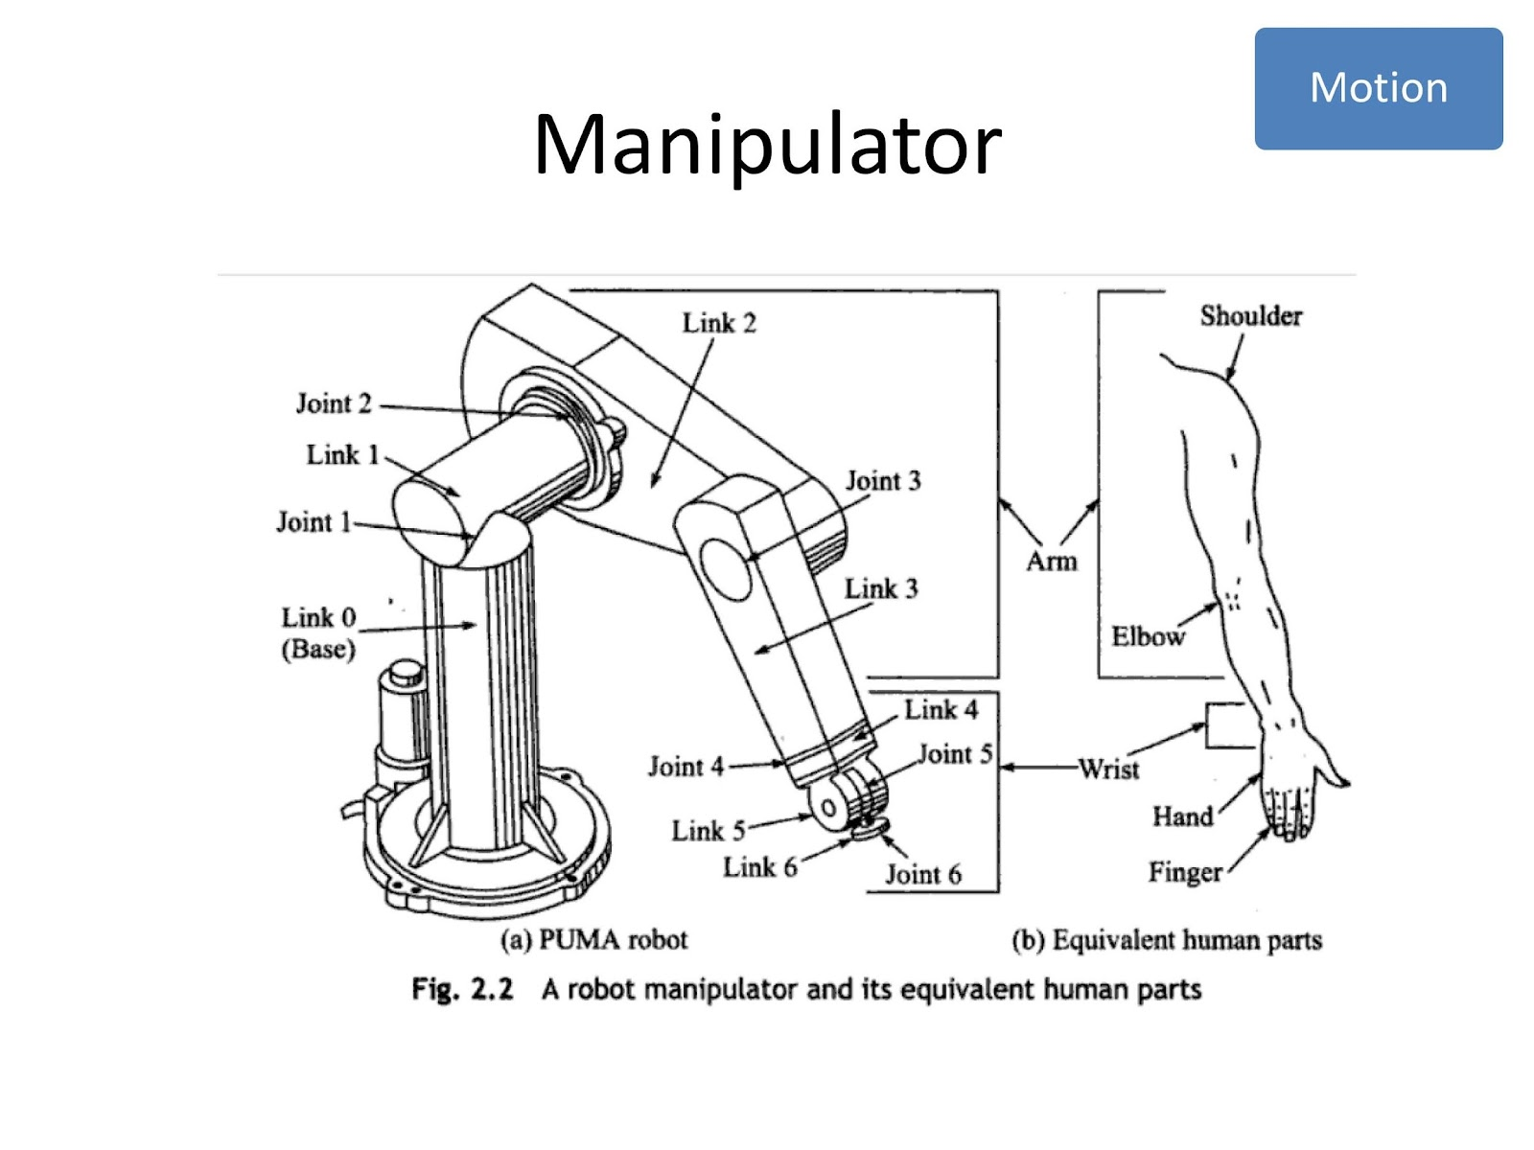

Slide 15
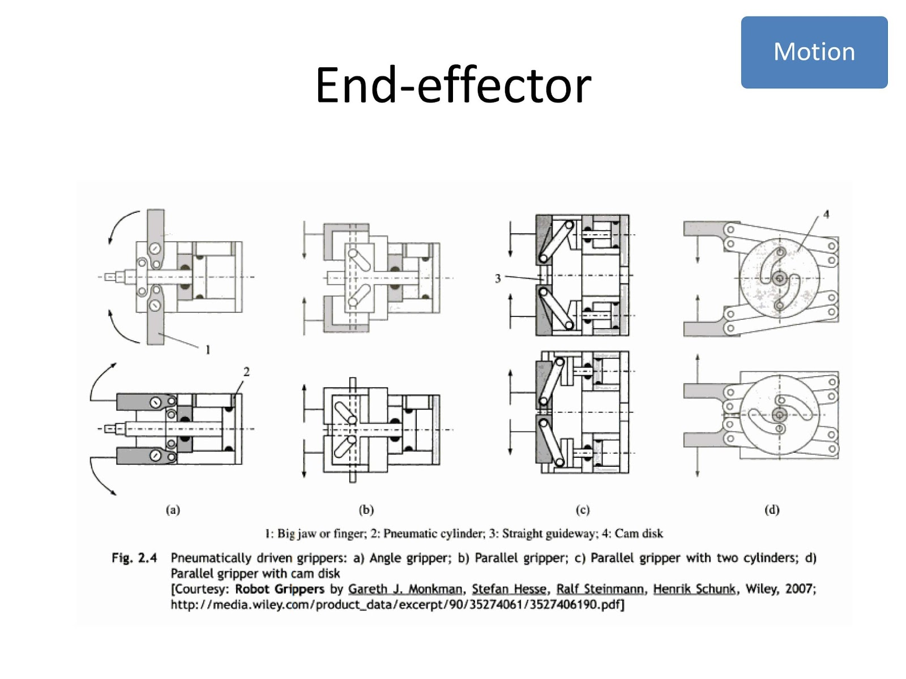

Slide 16
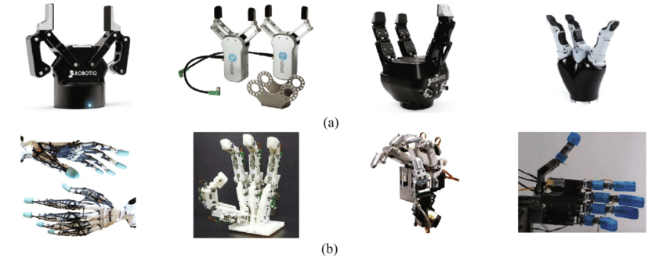
End Effector
Two types of fingered end-effectors: (a) gripper type, (b) anthropomorphic type

Slide 17
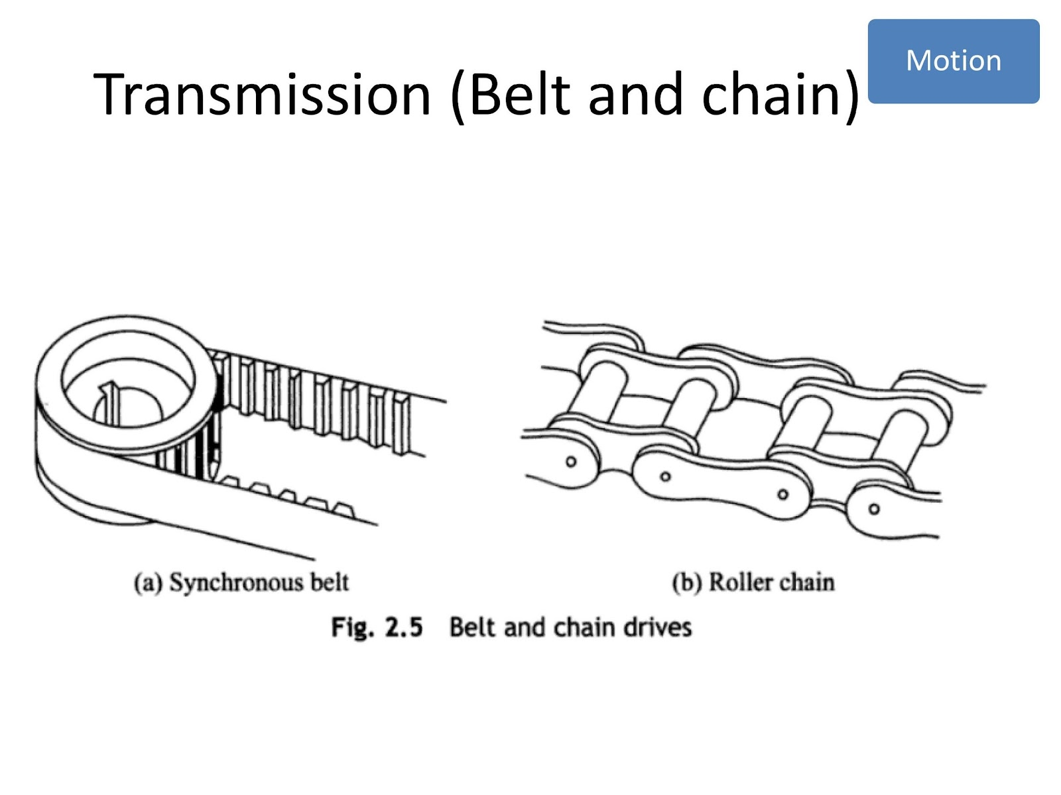

Slide 18
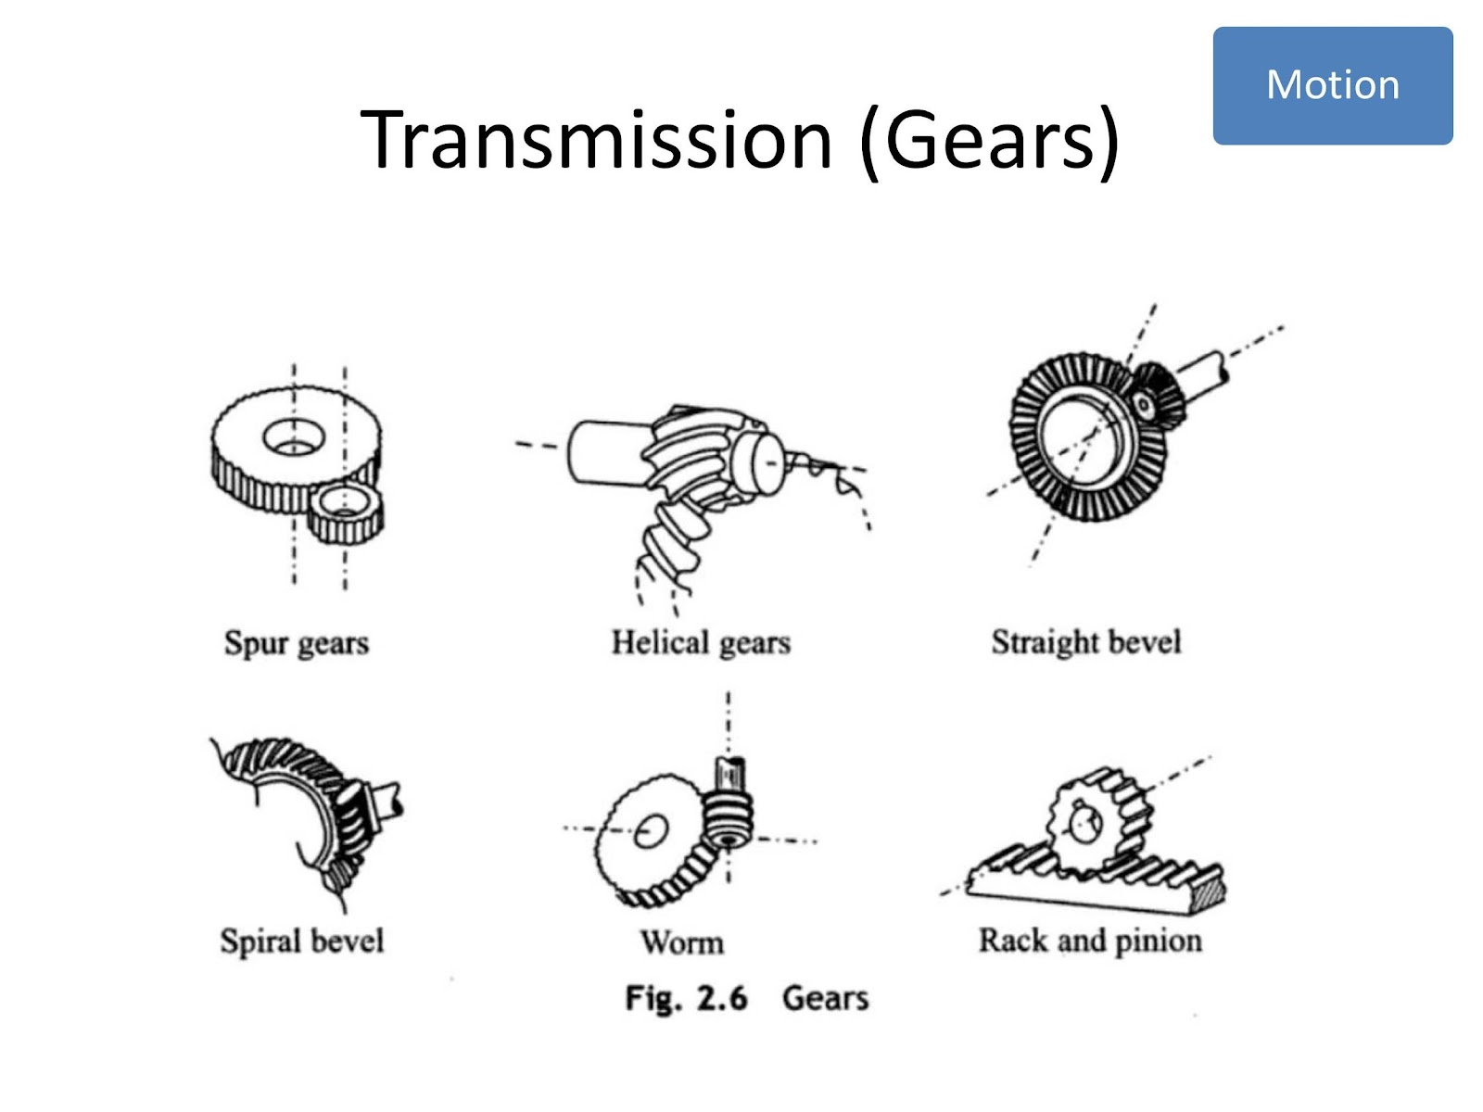

Slide 19
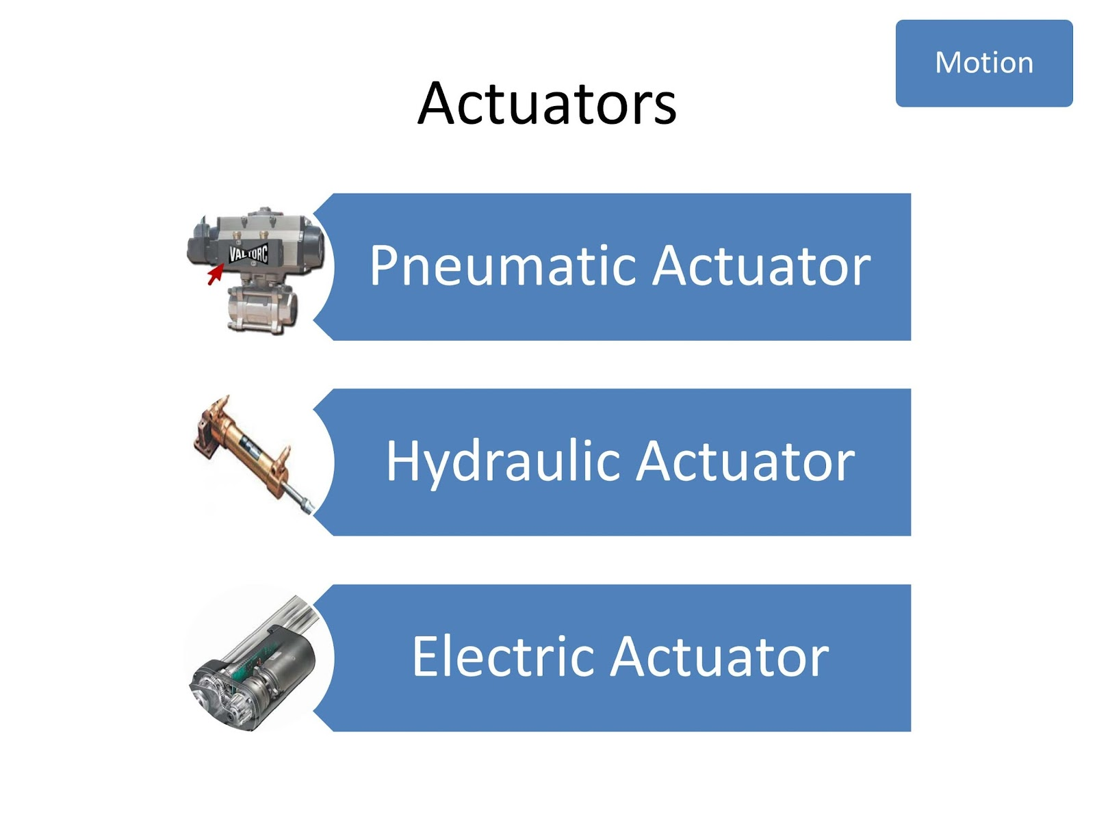

Slide 20
Pneumatic

Slide 21
Hydraulic

Slide 22
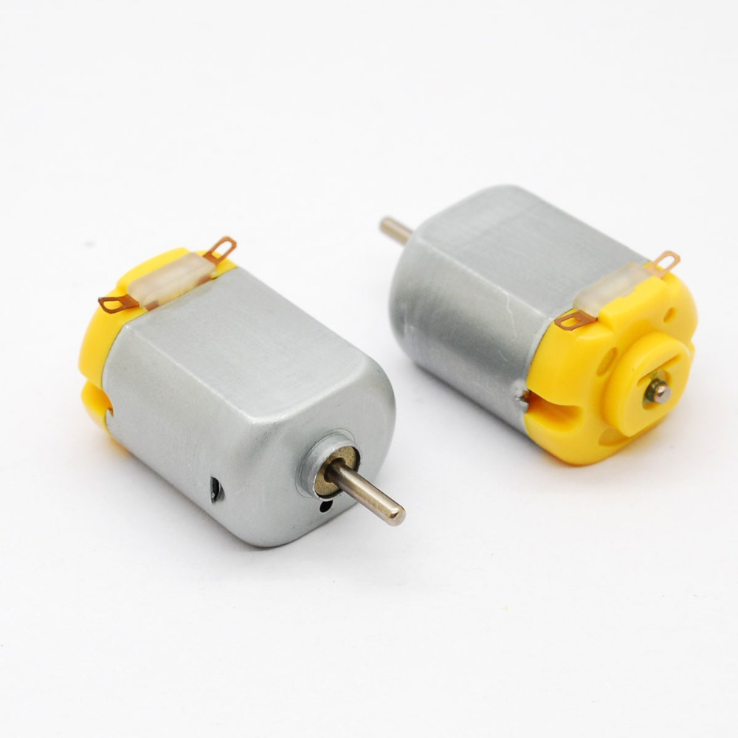
Electric

Slide 23
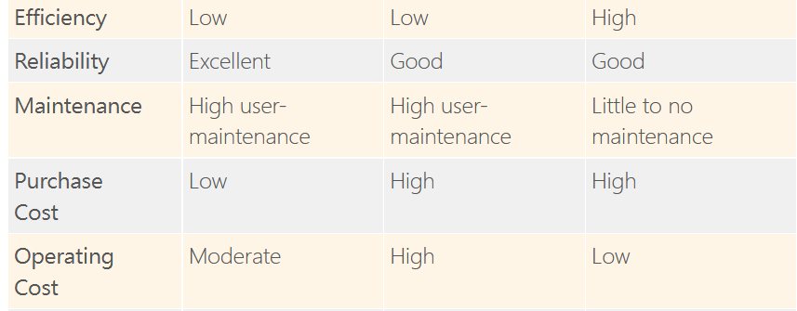

Slide 24
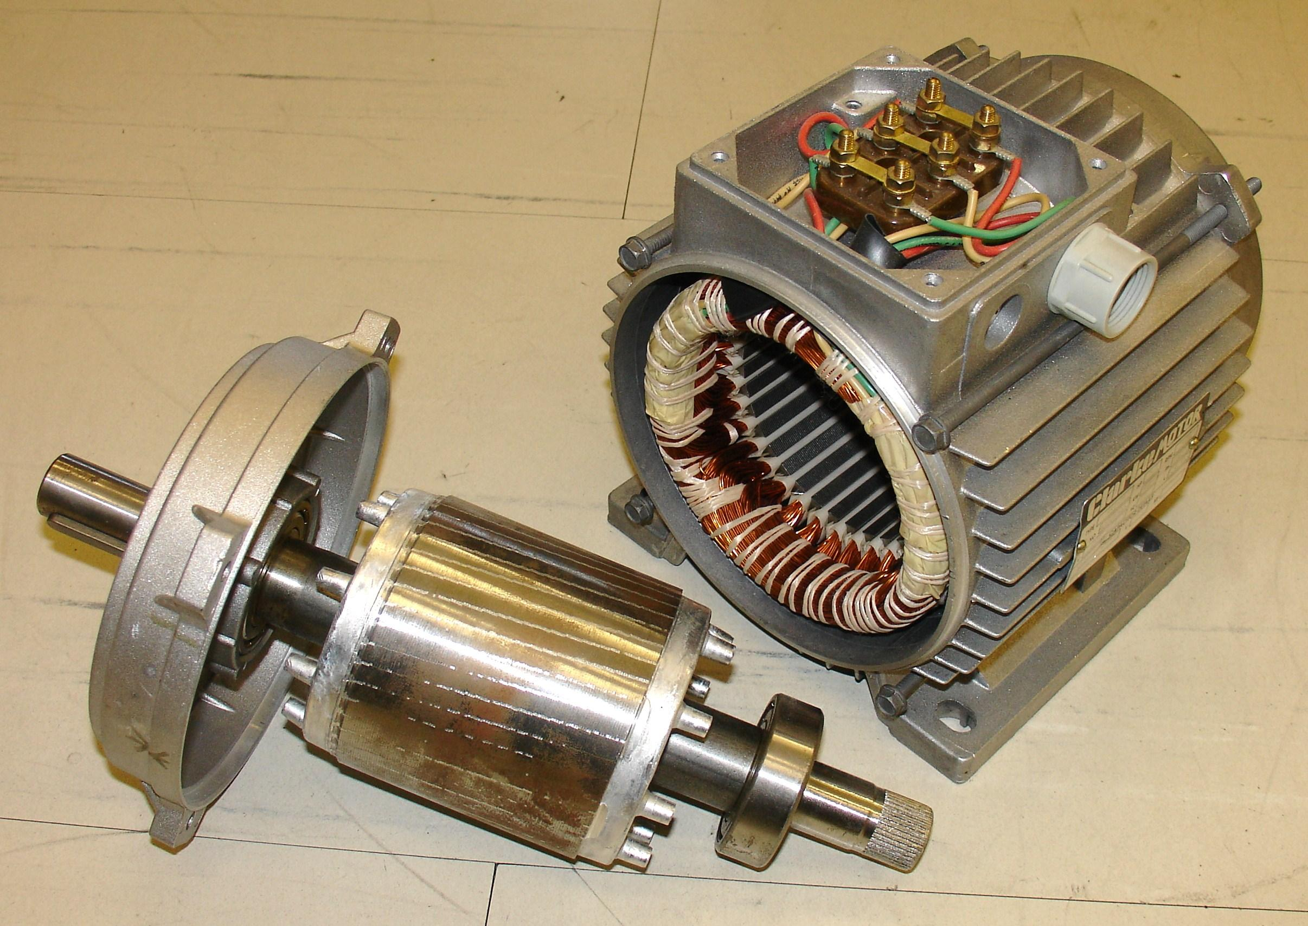
Motor
Stator
Rotor

Slide 25
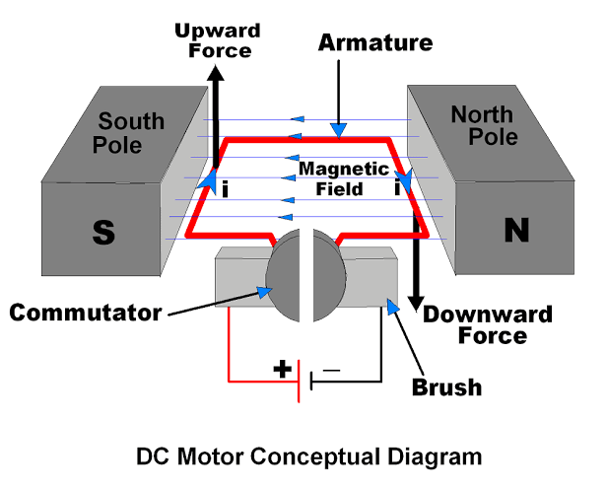
DC motor
https://youtu.be/LAtPHANEfQo

Slide 26
DC motor
https://youtu.be/LAtPHANEfQo

Slide 27
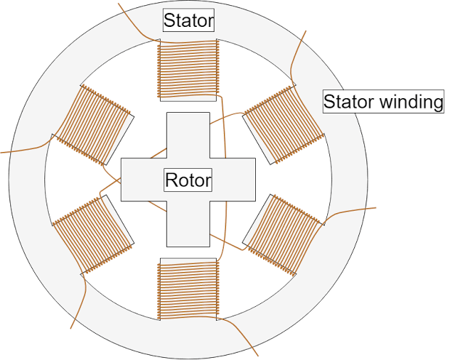
Stepper Motor
https://youtu.be/eyqwLiowZiU

Slide 28
Stepper Motor
https://youtu.be/eyqwLiowZiU

Slide 29
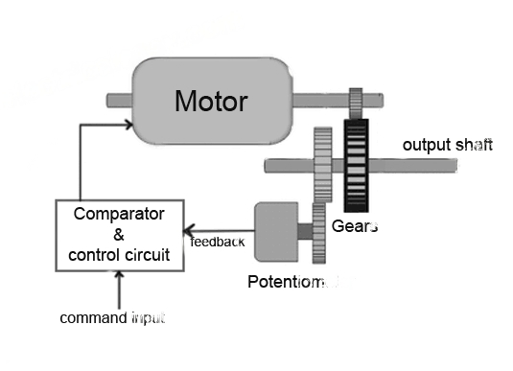
Servo Motor

Slide 30
Next Class
Quiz

Slide 31
Thank You

